Slide 1
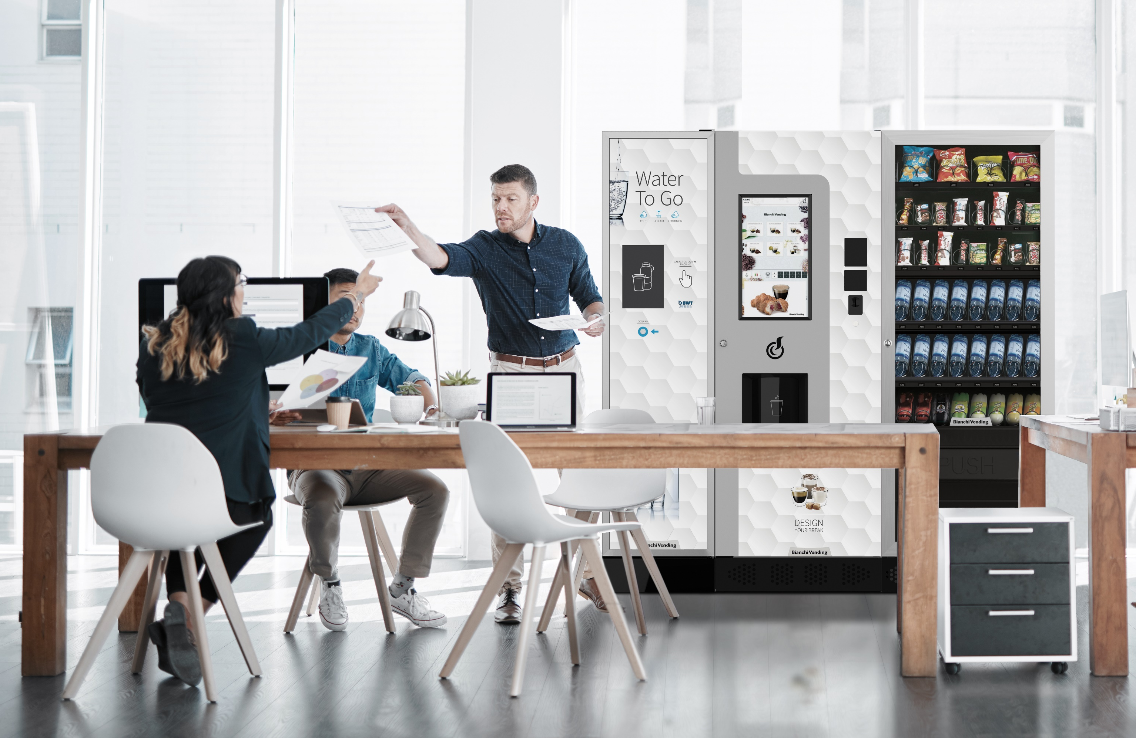
In co-operation with
Der Vending-Markt in Österreich
Published in September 2022
Photo: Bianchi Industry

Slide 2
Geographical Scope
The full EVA Market Report covers 24 European countries: Austria, Belgium, Czechia Republic, Denmark, Finland, France, Germany, Greece, Hungary, Republic of Ireland, Italy, Netherlands, Norway, Poland, Portugal, Romania, Russia, Slovakia, Spain, Sweden, Switzerland, Türkiye, United Kingdom & Ukraine.
Map: www.mapchart.net

Slide 3
Key Market Insights Austria
Overview
2. Gruppe Automatenzahl, Verkäufe, Umsatz
3% der gesamten Automaten in Europa
65 Personen pro Automat (Eur. Durchs. = 175)
Umsatz = €747 Millionen* in 2021, 9% mehr
3 Millionen Getränke und Lebensmittel am Tag verkauft
Ungefähr 80% der Automaten stehen am Arbeitsplatz
1900 direkt angestellt
87% Heiβgetränke
9% Kaltgetränke
3% Snacks
1% Lebensmittel
* In 2020, Austria performed the best of the 24 countries covered by these reports, and 2021 saw a good recovery. Significant investment in new machines (back to 2019 levels) delivered base growth, consumption recovered slightly and prices increased which all combined to give good product revenue growth.
Sources: 2023 interviews with operators, vending industry suppliers & experts; plus EVMMA data and team analysis

Slide 4
Key Market Metrics
Overall growth in Machine Base, Number of Vends & Product Revenue.
Total Machine Base – in thousands
+ 3.7% vs. 2020
Total Number of Vends - in millions
+ 4.7% vs. 2020
Total Product Revenue – in € millions
+ 8.7% vs. 2020
Sources: 2023 interviews with operators, vending industry suppliers & experts; plus EVMMA data and team analysis

Slide 5
Overall Vending Fieldbase by Machine Category I
Machine category as a percentage of total Fieldbase
Hot Beverage is divided into 2 categories:
Hot Beverage – Vending which comprises free standing and table top automatic.
Hot Beverage – OCS which, in this report, comprises Table Top Semi Automatic only; capsules are excluded, and pour over are out of scope.
For Austria, a significant part of OCS is capsules, so this report covers only part of the total OCS base.
Sources: 2023 interviews with operators, vending industry suppliers & experts; plus EVMMA data and team analysis

Slide 6
Hot Beverage Machine Base Evolution
Significant switch from Instant to Bean-to-Cup Coffee. Accelerating switch to Table Top Semi Automatic from Free Standing.
Total Hot Beverage Machine Base - Share by Coffee Type
Total Hot Beverage Base - Share by Machine Type
Please note: Table top capsule machines and pour over filter coffee machines are outside the scope of this report
Sources: 2023 interviews with operators, vending industry suppliers & experts; plus EVMMA data and team analysis

Slide 7
Cold, Snack Food & Combi Machine Base Evolution
Combi machines account for 32% of the non-hot machine base. For Snack (dedicated) and Combi, Cold (≤ 4˚C) machines are growing rapidly at the expense of Ambient + Chilled.
Cold, Snack, Food & Combi Machine Base - Share by Type
Snack (dedicated) and Combi Machine Base - Share by Type
Definitions:
Mainly glass front machines
Ambient machines have no chilling, while Chilled machines cool down to 5˚C
Cold machines cool to ≤ 4˚C and have a health cut-out if the temperature rises above 5˚C
Sources: 2023 interviews with operators, vending industry suppliers & experts; plus EVMMA data and team analysis

Slide 8
Snack (dedicated) and Combi machine base development I
Strong growth overall fueled by significant investment in Cold (≤ 4˚C) machines.
Snack (dedicated) and Combi Machine Base – in thousands
+ 10.6% vs. 2020
Snack (dedicated) and Combi Machine Base
Machine Category as percentage (%)
Sources: 2023 interviews with operators, vending industry suppliers & experts; plus EVMMA data and team analysis

Slide 9
Number of Vends by Product Category I
Growth in all categories, especially non-Hot Beverage, due to an increase in both base and consumption. Still well below 2019 levels.
Total Vends – in millions
+ 4.7% vs. 2020
Total Vends
Product Category as percentage (%)
Sources: 2023 interviews with operators, vending industry suppliers & experts; plus EVMMA data and team analysis

Slide 10
OCS & Vending Product Revenue by Category I
Significant growth in all categories due to increases in the base, consumption and price. A big step back towards 2019 levels.
OCS & Vending Product Revenue (incl VAT) – € millions
+ 8.7% vs. 2020
AUSTRIA: OCS & Vending Product Revenue (incl VAT)
Product Category as percentage (%)
Sources: 2023 interviews with operators, vending industry suppliers & experts; plus EVMMA data and team analysis

Slide 11
Hot Beverage - Cup Types and Sizes
Paper has a share of around 65% of single-use cups. The leading cup size is 5-7oz / 120-180ml.
Cup Type Distribution
Cup Size Distribution
Based on operator sample so around +/- 10% accuracy
Based on operator sample so around +/- 10% accuracy
Results are rounded to nearest 5% and has an estimated accuracy of +/- 10%.
Sources: 2023 interviews with operators, vending industry suppliers & experts; plus EVMMA data and team analysis

Slide 12
Payment Systems & Telemetry
Cashless payment systems are now fitted to half the machine base.
Payment System Types on Pay Vend Machines
There is continuing investment into cashless payment systems for vending. It is more convenient for consumers and tends to result in higher consumption and higher average spend per transaction compared to cash sales.
Around 60% of the pay vend machine base is now
equipped with a cashless payment option. Around 25% of these machines accept credit / debit card and mobile phone payments. The remaining 75% are closed systems using dedicated cards or keys, or company access cards.
Telemetry is now being actively used by operators on around 10% of the machine base. The most popular uses of telemetry are alerts for technical faults and out of stock. Dynamic route planning is now starting with some operators
Based on operator sample so around +/-10% accuracy
Sources: 2023 interviews with operators, vending industry suppliers & experts; plus EVMMA data and team analysis

Slide 13
GFK Verbraucherstudie

Slide 14
GFK Verbraucherstudie

Slide 15
Becherstudie 2023

Slide 16
European Vending &
Coffee Service Association
Rue van Eyck 44
1000 Brussels
Belgium
www.vending-europe.eu
vending@vending-europe.eu
Photo: ETNA Coffee Technologies

